Slide 1


Introduction to Cloud Computing with R in Google Cloud and Amazon Web Services Session 2:A recap/introduction to r
Sounak Chakraborty
Associate Professor, Department of Statistics
http://faculty.missouri.edu/chakrabortys/

Slide 2
Contents
What is R and Rstudio ?
Importing data in R.
Some basic statistics tools in R for data manipulation.
Graphs and plots in R.
Some advanced statistical procedures in R for analyzing data.
Linear, logistic, and multinomial regressions in R.
Analysis of Variance in R.
Summary.

Slide 3
What is R ?
R is a statistical software.
It is free. It can be downloaded free of cost from http://www.r-project.org.
It runs on multiple platforms (e.g., Windows, Unix, Linux, and Mac).
It contains thousands of basic and advanced statistical procedures. It is still growing rapidly, as more users are sharing their codes through http://www.r-project.org or independently through software repository like github.
Graphs and plots are very easy to draw using R.

Slide 4
What is R ?
R has three basic windows or sessions.
R Console: In this window when codes are submitted, all calculations are done, and results are obtained. Error messages will also be printed in this window.
R Graphics: Graphs are generated in this window.
R Editor: Here you can write your code and save it in .R format.
You can submit your code to R Console by simply cutting and pasting it from your doc, txt, html, or .R files. The other option is to type/write your code in the R Console directly.

Slide 5
R libraries
R libraries are toolboxes that has some specific function or job.
To use a specific statistical tool you need to load the corresponding R library.
Libraries are loaded by issuing the following command in the R console in the beginning: library(name)
The list of Libraries used in this presentation are listed in Libraries.R file.

Slide 6
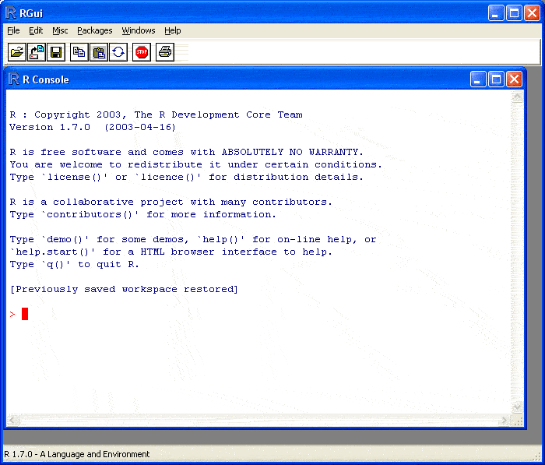
R Console window

Slide 7
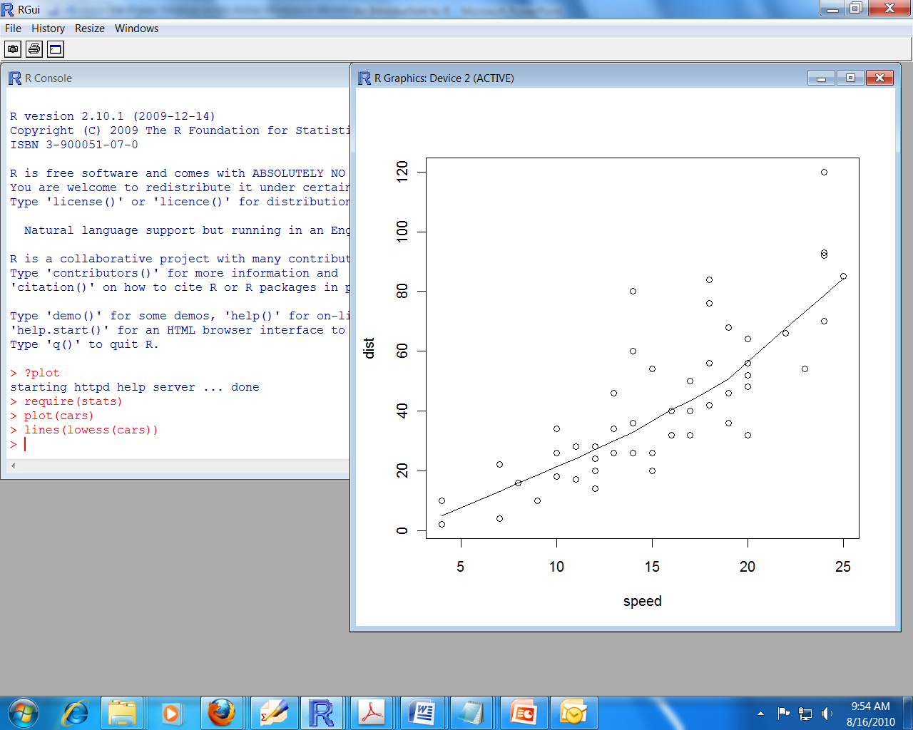
R Graphics window

Slide 8
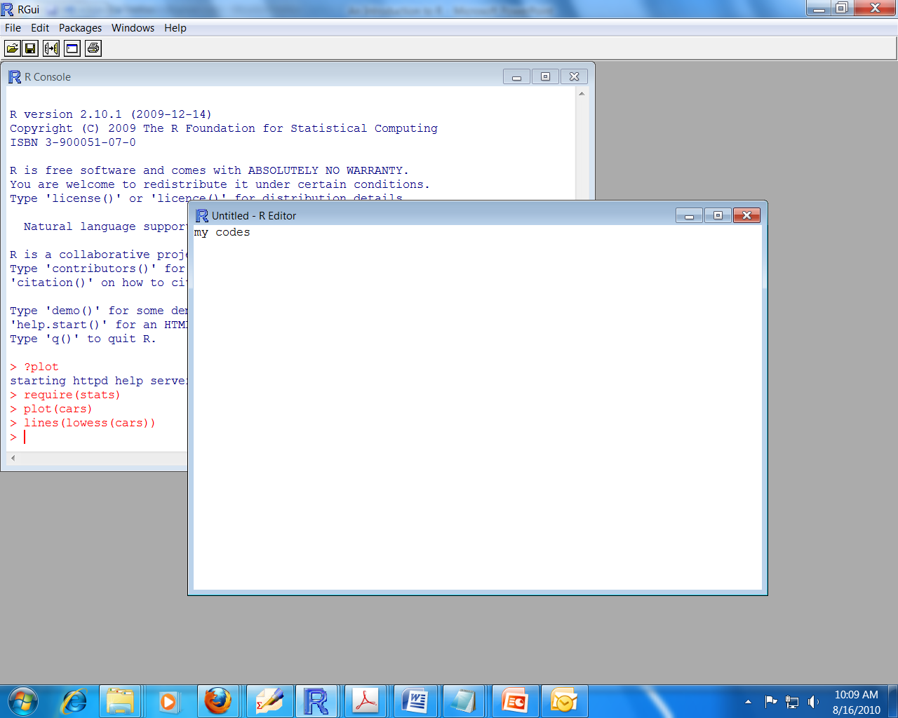
R Editor window

Slide 9
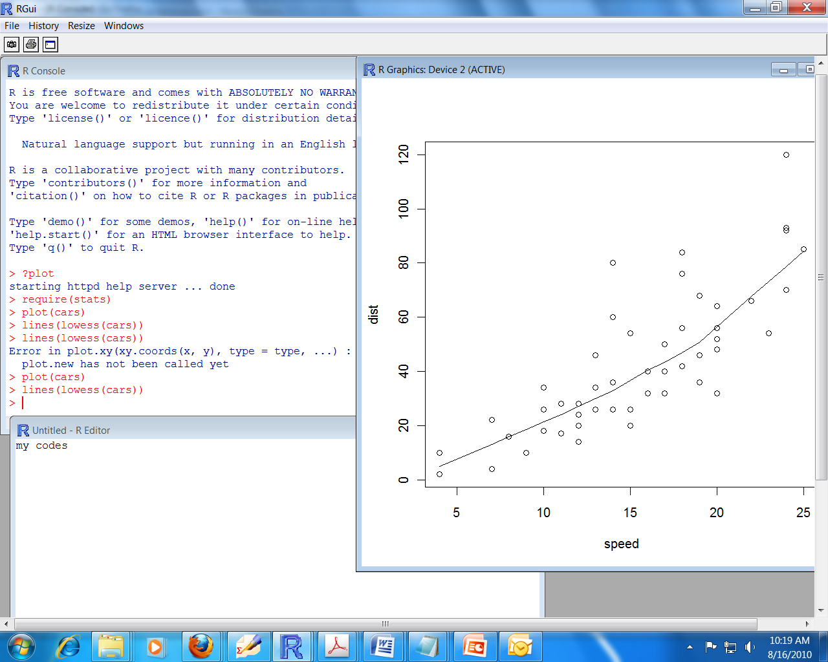
A full R session

Slide 10
What is rstudio ?
RStudio is an integrated development environment (IDE) for R language. It is a R code editor and development environment.
RStudio is designed to make it easy to write scripts
As soon as you create a new script, the windows within your RStudio session adjust automatically so you can see both your script and the results in your console when you run your syntax.
RStudio makes it convenient to view and interact with the objects stored in your environment.
In the basic R GUI, you can always list the objects you have stored in your environment. But RStudio has a very useful “Environment” window available.
RStudio makes it easy to set your working directory and access files on your computer.
With RStudio, you can navigate to folders on your computer in the “Files” window, view any files you have in that folder, and set that folder as the working directory.
RStudio makes graphics much more accessible for a casual user-
The basic R GUI requires you to go to some lengths to save graphics as you go. But RStudio has a window that does exactly that. You can easily click back and forth between plots, change the sizes of your plot without rerunning the code, and export or copy plots to include in other documents.

Slide 11
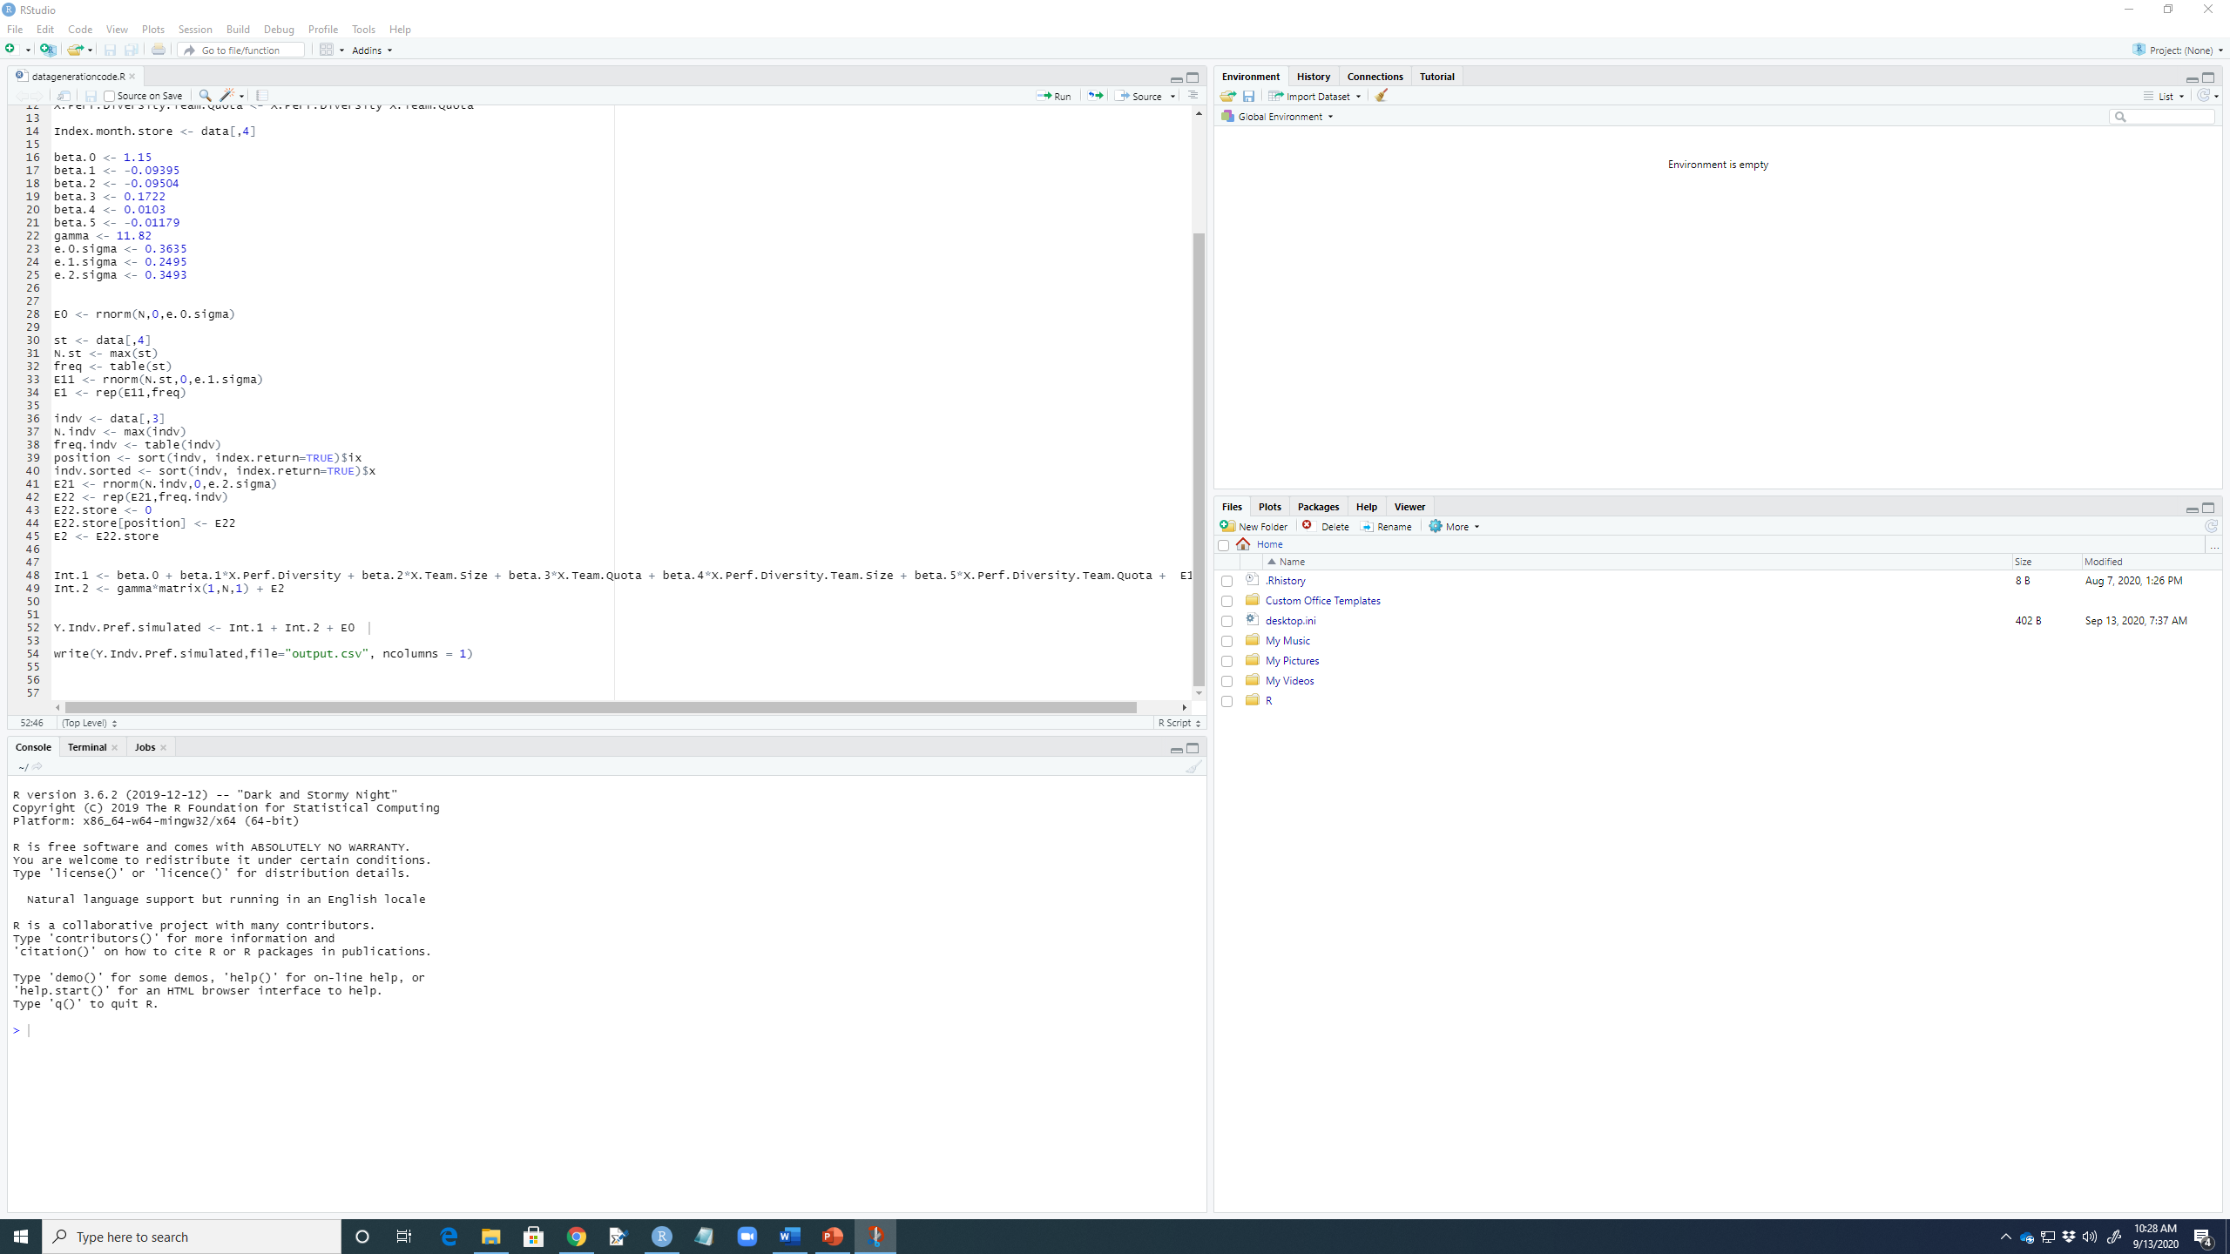
Rstudio interface

Slide 12
An efficient project management scheme
Under the MyProject folder create “Code” folder. Here you will store all R programs.
Under the MyProject folder create “Results” folder. Here you will store all outputs, graphs, and results.
Create a project folder “MyProject”
Under the MyProject folder create “Data” folder. Here you will store all project related data sets.
Set your working directory
R Console > Change dir > …>MyProject > Data

Slide 13
Importing data in R
Reading text file (.txt, .dat, etc).
Reading directly from web.
Reading Excel spreadsheets.
Importing SAS, SPSS, and Stata data sets.

Slide 14
Reading a text file in R
read.table(): The function read.table is the most convenient way to read in a rectangular grid of data.
read.table("file1.txt", header = TRUE, row.names = 1, sep = ", "): header = TRUE: The file contains the names of the variables as its first line. row.names = 1: This can be a vector giving the actual row names, or a single number giving the column of the table which contains the row names (present scenario), or character string giving the name of the table column containing the row names. If row.names is missing, the rows are numbered automatically. sep = ", ": The field separator to be used. Default option is space.
Missing values: By default the file is assumed to contain the character string NA to represent missing values, but this can be changed by the argument na.strings, which is a vector of one or more character representations of missing values.

Slide 15
Reading a text file in R
data1 <- read.table("file1.txt", header = TRUE)
data2 <- read.table("file2.txt", header = TRUE, na.strings=".")
data3 <- read.table("file3.txt", header = TRUE, sep=", ")
To extract only the age column type data1$age.

Slide 16
Reading a text file in R
read.table() is an inefficient way to read in very large numerical matrices.
scan(): If you want to efficiently read the data directly in a large matrix.
Suppose file ‘data.dat’ just contains the numbers for a 20 x 10 matrix. Then we can use,
data <- matrix(scan("data.dat", n = 20*10), 20, 10, byrow = TRUE)
matrix() creates a matrix from the given set of values.
byrow = TRUE (the default): the matrix is filled by columns, otherwise the matrix is filled by rows.

Slide 17
Reading data directly from internet
http://faculty.missouri.edu/~micheasa/stat7110/datasets/
A1<-read.table("http://faculty.missouri.edu/~micheasa/stat7110/datasets/fitness.dat", header=T)
It will read directly from the web.

Slide 18
Reading Excel spreadsheets
If you have access to Excel (xls/xlsx format), export/save the data as tab-delimited or comma-separated form, and use read.delim() or read.csv() to import it into R. read.delim() or read.csv() are similar to read.table().
read.csv("fuel.csv")
Other option is use the library gdata
library(gdata)
Data1.xls <- read.xls("fuel.xls")
Data2.xls <- read.xls("IsThereASantaClaus.xls")

Slide 19
Importing SAS, SPSS, and Stata data sets
The package foreign provides import facilities for files produced by these statistical systems.
SPSS
library(foreign)
Data.spss <- read.spss("HSB500.SAV", to.data.frame = TRUE)
Data.spss
STATA
library(foreign)
Data.stata <- read.dta("guyer.dta")
Data.stata

Slide 20
Importing SAS, SPSS, and Stata data sets
SAS .sas7bdat format
library(sas7bdat)
Data.sas1 <- read.sas7bdat("airline.sas7bdat")
Data.sas1
SAS .xpt format
library(SASxport)
Data.sas2 <- read.xport("test2.xpt")
Data.sas2

Slide 21
References for data imports
http://cran.r-project.org/web/packages/foreign/foreign.pdf
http://cran.r-project.org/doc/manuals/R-data.pdf

Slide 22
How to write/store the data/results from r in a file
write(): The data (usually a matrix) x are written to a file. If x is a two-dimensional matrix you need to transpose it to get the columns in file the same as those in the internal representation.
A1<-read.table("http://faculty.missouri.edu/~micheasa/stat7110/datasets/fitness.dat", header=T)
write(t(A1),file="writeoutput.csv", ncolumns=7)
write(t(A1),file="writeoutput.txt", ncolumns=7)

Slide 23
Descriptive statistics and maths
summary(): gives some very basic statistics.
data1 <- read.table("CARS93.dat")
summary(data1)
Standard deviation: sd(data1$V4)
variance: var(data1$V4)
Correlation: cor(data1$V4, data1$V5,method = "pearson")
Testing Correlation: cor.test(data1$V4, data1$V5,method = "pearson")
SORTING:
sort(data1$V4) # sort in ascending order
rev(sort(data1$V4)) # sort in descending order

Slide 24
Some basic statistics and maths
Matrix operations:
V <- c(1,5,6,7,9): defining a vector.
a<-rbind(c(1,1,1),c(2,2,2),c(3,3,3))
b<-rbind(c(1,2,3),c(1,2,3),c(1,2,3))
C <- a%*%b: Matrix multiplication.
solve(C) : Matrix inverse.
c1 <- diag(5,10)
solve(c1)
C[1,]: first row of matrix C.
C[,1]: first column of matrix C.

Slide 25
Generating random variables
Binomial: rbinom(# RN, n, p): rbinom(100, 10, 0.3)
Poisson: rpois(# RN, lambda): rpois(100, 5)
Normal: rnorm(# RN, mean = 0, sd = 1): rnorm(100, mean = 10, sd = 3)
Gamma: rgamma(# RN, shape=1, scale = 1): rgamma(50, shape=3, scale = 2)
T: rt(# RN, df): rt(100, 5)
Chi-sq: rchisq(# RN, df): rchisq(100, 5)
Beta: rbeta(# RN, param1, param2): rbeta(100, 3, 2)

Slide 26
Graphs and plots
Stem-n-leafs
x<-rpois(n=100,lambda=15)
# 100 generated values from a poisson with lamda=15
x
stem(x)
Boxplots
x=rnorm(100) # generate 100 values from a standard normal
y=rnorm(100,mean=0,sd=2)
# generate 100 values from a normal with mean=0 and standard deviation=2
# one and side by side boxplots with appropriate labels
boxplot(x) # one box plot
boxplot(x,y,names=c("Normal(0,1)","Normal(0,4)"), main="Side by Side Boxplots")

Slide 27
Graphs and plots
Histograms
main.title="Histogram of a normal distribution"
par(mfcol=c(1,2), las=1)
# tells R to split the graphics device into a matrix 1x2 (side by side plotting)
hist(x,ylim=c(0,35),xlim=c(-7,7),xlab="Normal(0,1)",main=main.title)
hist(y,ylim=c(0,35),xlim=c(-7,7),xlab="Normal(0,4)",main=main.title)
General Plotting in 2-d
a<-scan("names.txt", list(Name="", Gender="", Age=0, Height=0, Weight=0),multi.line=T)
z<-data.frame(a)
par(mfrow=c(1,1))
plot(z$Age,z$Height,xlim=c(10,17),ylim=c(500,650))
symbols(z$Age,z$Height,circles=z$Weight,add=T)

Slide 28
t-tests
t.test(x, y=NULL, alternative="two.sided", mu=0, paired=F,var.equal=F, conf.level=.95)
Performs a one-sample, two-sample, or paired t-test, or a Welch modified two-sample t-test.
x: numeric vector, y: numeric vector.
If paired=TRUE, then x and y must have the same length, observation pairs (x[i], y[i]).
alternative: character string, one of "greater", "less" or "two.sided", indicating the specification of the alternative hypothesis.
mu: a single number representing the value of the mean or difference in means specified by the null hypothesis.
paired: logical flag if TRUE, x and y are considered as paired vectors.
var.equal: if TRUE, the variances of the parent populations of x and y are assumed equal. Argument var.equal should be supplied only for the two-sample tests.
conf.level: confidence level for the returned confidence interval, restricted to lie between zero and one.

Slide 29
t-tests
#One-sample t-test, data from a normal distribution
x<-rnorm(100,mean=15,sd=3)
t.test(x) # tests mean=0 at a=.05
t.test(x,mu=15,conf.level=.90)
#One-sample t-test, data from non-normal distributions, n large
y<-rpois(100,lambda=10)
t.test(y,mu=10,conf.level=.90)
z<-rbinom(150,size=10,prob=.8)
t.test(z,mu=7,conf.level=.95)

Slide 30
t-tests
#Two independent samples t-test, data from normal distr
x<-rnorm(15,mean=3,sd=2)
y<-rnorm(30,mean=3.5,sd=3)
t.test(x, y, mu=0) # assuming un-equal variances (Welch-approx to df.)
t.test(x, y, mu=0,var.equal=T) # assuming equal variances
#Paired t-test
library(mvtnorm)
xy<-rmvnorm(15,mean=c(3,7),sigma=rbind(c(1,2.4),c(2.4,16)))
# correlated data, using rho=.6
t.test(xy[,1],xy[,2], alternative="less", paired=T)

Slide 31
Test used when normality assumption is not justified
wilcox.test(x, y, alternative="two.sided", mu=0, paired=F, exact=T,correct=T)
Paired sample test
Hamilton depression scale factor measurements in 9 patients with mixed anxiety and depression, taken at the first (x) and second (y) visit after initiation of a therapy (administration of a tranquilizer).
x <- c(1.83, 0.50, 1.62, 2.48, 1.68, 1.88, 1.55, 3.06, 1.30)
y <- c(0.878, 0.647, 0.598, 2.05, 1.06, 1.29, 1.06, 3.14, 1.29)
wilcox.test(x, y, paired = TRUE, alternative = "greater")

Slide 32
Test used when normality assumption is not justified
two-sample test
Permeability constants of the human chorioamnion (a placental
membrane) at term (x) and between 12 to 26 weeks gestational
age (y). The alternative of interest is greater permeability
of the human chorioamnion for the term pregnancy.
x <- c(0.80, 0.83, 1.89, 1.04, 1.45, 1.38, 1.91, 1.64, 0.73, 1.46)
y <- c(1.15, 0.88, 0.90, 0.74, 1.21)
wilcox.test(x, y, alternative = "g")

Slide 33
Tests for independence
Pearson's Chi-squared test
chisq.test(x)
#Performs a Pearson's chi-square test on a two-dimensional contingency table.
#This test is relevant to several types of null hypothesis:
#statistical independence of the rows and columns, homogeneity of groups, etc.
# first create two factor objects (categorical variables)
c<-rbind(c(25,10),c(9,30))
dimnames(c)<-(list(c('Cat','Dog'),c('Dry','Wet')))
chisq.test(c)

Slide 34
Tests for independence
fisher.test(x)
#Performs a Fisher's exact test on a two-dimensional contingency table.
#Fisher's exact test is typically used to test the null hypothesis of independence between the row and column variables of the table. Certain types of homogeneity,
#for example homogeneity of proportions in a k by 2 table, are equivalent to the independence hypothesis.
fisher.test(c)

Slide 35
Tests for normality assumption
Kolmogorov-Smirnov test
ks.test()
# one sample
x <- rnorm(1000)
ks.test(x,pnorm,0,1) # p-value not small implies normal
ks.test(x,pnorm,mean(x),sd(x)) # p-value not small implies normal
ks.test(x,pt,2) # p-value small implies not t-distribution
ks.test(x,pchisq,2) # p-value small implies not chisq-distribution
# two sample
x <- rnorm(90)
y <- rnorm(8, mean = 2.0, sd = 1)
ks.test(x, y) # testing the equality of distribution of x and y

Slide 36
Goodness of fit using qqplots
qqnorm(x) # plot against normal quantiles, want straight line to assume normal population
qqline(x) # add a line through the points
qqplot(x,y,plot=T) # plot quantiles of x vs y
x<-rnorm(100,3,2)
qqnorm(x)
qqline(x,col=2)
y<-rpois(15,20)
qqnorm(y)
qqline(y)

Slide 37
Adding Lines to plots
abline(a, b) # intercept and slope
abline(coef) # intercept and slope given as a vector
abline(reg) # a regression object, typically reg$coef will be used
abline(h=, v=) # add horizontal and vertical lines on a plot
zz <- qqplot(x, y, plot = F)
plot(zz) # plot it
abline(lm(zz$y~zz$x),col=3) # add the line from a least squares fitted regression line

Slide 38
Linear Models/regressions
lm(formula, data = …)
Returns an object of class "lm" that represents a fit of a linear model.
x<-seq(-15,100,length=100)
y<-x+rnorm(100,0,15)
fit<-lm(y~x)
summary(fit)
par(mfrow=c(2,2))
plot(fit)

Slide 39
Linear Models/regressions
Check for independence:
resid<-residuals(fit)
# all three of these do the same thing
plot(resid)
plot(fit$residuals)
plot(residuals(fit))
Checks for normality:
hist(resid)
qqnorm(resid)
qqline(resid)
ks.test(resid,mean(resid),sd(resid))

Slide 40
Linear Models/regressions
Confidence Intervals
par(mfrow=c(1,1))
plot(x,y)
points(x,fitted.values(fit),type="l",col=2)
cbounds<-predict(fit,se.fit=T,level=.90,interval="prediction")
points(x,cbounds$fit[,2],type="l",col=3)
points(x,cbounds$fit[,3],type="l",col=3)
cbounds<-predict(fit,se.fit=T,level=.90,interval="confidence")
points(x,cbounds$fit[,2],type="l",col=4)
points(x,cbounds$fit[,3],type="l",col=4)
Since n is large the bounds are very narrow

Slide 41
Linear Models/regressions
The maximum heart rate of a person is often said to be related to age by the equation
Max = 220 - Age
Suppose this is to be empirically proven and 15 people of varying ages are tested for their maximum heart rate. The following data is found:
Age 18 23 25 35 65 54 34 56 72 19 23 42 18 39 37
Max Rate 202 186 187 180 156 169 174 172 153 199 193 174 198 183 178
x <- c(18,23,25,35,65,54,34,56,72,19,23,42,18,39,37)
y <- c(202,186,187,180,156,169,174,172,153,199,193,174,198,183,178)
lm.heart<- lm(y ~ x) # plot the regression line
summary(lm.heart)
plot(x,y) # make a plot
abline(lm.heart)
resid <- resid(lm.heart) # residuals
ks.test(resid,mean(resid),sd(resid))

Slide 42
Linear Models/regressions
Prediction
lm.pred <- predict(lm.heart)
lm.pred
predict(lm.heart,data.frame(x= c(50,60)))
Diagnostic plots
par(mfrow=c(2,2))
plot(lm.heart)
Confidence interval
predict(lm.heart,data.frame(x=sort(x)), level=.9, interval="confidence")

Slide 43
ANOVA Models
aov(formula, data = <<see below>>, contrasts = NULL)
Building Models: Terms Included Functionality
A+B Main effects of both A and B
A:B Interaction effect of A and B
a<-scan("names.txt", list(Name="", Gender="", Age=0, Height=0, Weight=0),multi.line=T)
ourdata<-data.frame(a)
height.level<-factor( cut(ourdata$Height,breaks=c(500,550,580,600), labels=c("Short","Normal","Tall")) )
age.factor<-factor(ourdata$Age)
aovfit<-aov(Weight~height.level+age.factor, data=ourdata)
summary(aovfit)

Slide 44
Logistic Regression for Binary response
library(rpart)
kyphosis<-kyphosis
DATA DESCRIPTION:
Kyphosis: a factor telling whether a postoperative deformity (kyphosis) is "present" or "absent" .
Age: the age of the child in months.
Number: the number of vertebrae involved in the operation.
Start: the beginning of the range of vertebrae involved in the operation.
Note: Since the response is either 0(absent) or 1(present) it makes more sense to assume that Y~Binomial(1,p).
The logistic regression model:
fit.kyph<-glm(Kyphosis~Age+Number+Start,family=binomial,data=kyphosis)
summary(fit.kyph)

Slide 45
Logistic Regression for Binary response
Odds:
exp(coef(fit.kyph))
For every unit increase in covariate the odds increase multiplicatively by exp(corresponding coefficient estimate)
Diagnostic plots:
par(mfrow=c(2,2))
plot(fit.kyph)

Slide 46
Multinomial logistic regression
Multinomial regression is much similar to logistic regression but is applicable when the response variable is a nominal categorical variable with more than 2 levels. multinom() from nnet package is needed.
predict the choice of contraceptive preferred by women (1=No-use, 2=Long-term, 3=Short-term). education, work, religion, number of children, media exposure and standard of living as predictor variables.

Slide 47
Multinomial logistic regression
#Import data
cmcData <- read.csv("http://archive.ics.uci.edu/ml/machine-learning-databases/cmc/cmc.data", stringsAsFactors=FALSE, header=F)
colnames(cmcData) <- c("wife_age", "wife_edu", "hus_edu", "num_child", "wife_rel", "wife_work", "hus_occu", "sil", "media_exp", "cmc")
head(cmcData)
# convert numeric to factors
cmcData$wife_edu <- factor(cmcData$wife_edu, levels=sort(unique(cmcData$wife_edu)))
cmcData$hus_edu <- factor(cmcData$hus_edu, levels=sort(unique(cmcData$hus_edu)))
cmcData$wife_rel <- factor(cmcData$wife_rel, levels=sort(unique(cmcData$wife_rel)))
cmcData$wife_work <- factor(cmcData$wife_work, levels=sort(unique(cmcData$wife_work)))
cmcData$hus_occu <- factor(cmcData$hus_occu, levels=sort(unique(cmcData$hus_occu)))
cmcData$sil <- factor(cmcData$sil, levels=sort(unique(cmcData$sil)))
cmcData$media_exp <- factor(cmcData$media_exp, levels=sort(unique(cmcData$media_exp)))
cmcData$cmc <- factor(cmcData$cmc, levels=sort(unique(cmcData$cmc)))

Slide 48
Multinomial logistic regression
# Prepare Training and Test Data
set.seed(100)
trainingRows <- sample(1:nrow(cmcData), 0.7*nrow(cmcData))
training <- cmcData[trainingRows, ]
test <- cmcData[-trainingRows, ]
# Build multinomial model
library(nnet)
multinomModel <- multinom(cmc ~ ., data=training) # multinom Model
summary (multinomModel) # model summary
# Prediction, confusion matrix, misclassification error
predicted_scores <- predict (multinomModel, test, "probs") # predict on new data
predicted_class <- predict (multinomModel, test)
table(predicted_class, test$cmc)
mean(as.character(predicted_class) != as.character(test$cmc))

Slide 49
Sample size calculation and power analysis
Power analysis is an important aspect of experimental design. It allows us to determine the sample size required to detect an effect of a given size with a given degree of confidence. Conversely, it allows us to determine the probability of detecting an effect of a given size with a given level of confidence, under sample size constraints. If the probability is unacceptably low, we would be wise to alter or abandon the experiment.
The following four quantities have an intimate relationship:
sample size
effect size
significance level = P(Type I error) = probability of finding an effect that is not there
power = 1 - P(Type II error) = probability of finding an effect that is there
Given any three, we can determine the fourth.

Slide 50

Sample size calculation and power analysis
function | power calculations for
pwr.2p.test | two proportions (equal n)
pwr.2p2n.test | two proportions (unequal n)
pwr.anova.test | balanced one way ANOVA
pwr.chisq.test | chi-square test
pwr.f2.test | general linear model
pwr.p.test | proportion (one sample)
pwr.r.test | correlation
pwr.t.test | t-tests (one sample, 2 sample, paired)
pwr.t2n.test | t-test (two samples with unequal n)
Power Analysis in R
The pwr package implements power analysis. For each of these functions, you enter three of the four quantities (effect size, sample size, significance level, power) and the fourth is calculated.

Slide 51
Sample size calculation and power analysis
Suggested effect sizes:
Purpose | small | medium | large
T-test | 0.2 | 0.5 | 0.8
1 way ANOVA | 0.1 | 0.25 | 0.4
Correlation test | 0.1 | 0.3 | 0.5
Linear Regression | 0.02 | 0.15 | 0.35
For a one-way ANOVA comparing 5 groups, calculate the sample size needed in each group to obtain a power of 0.80, when the effect size is moderate (0.25) and asignificance level of 0.05 is employed.
pwr.anova.test(k=5,f=.25,sig.level=.05,power=.8)
What is the power of a one-tailed t-test, with a significance level of 0.01, 25 people in each group, and an effect size equal to 0.75?
pwr.t.test(n=25,d=0.75,sig.level=.01,alternative="greater")

Slide 52
summary
In this session we learnt how to read/write files and run some basic statistical analysis in r
Everything we learnt in this session is demoed using rstudio desktop

Slide 53
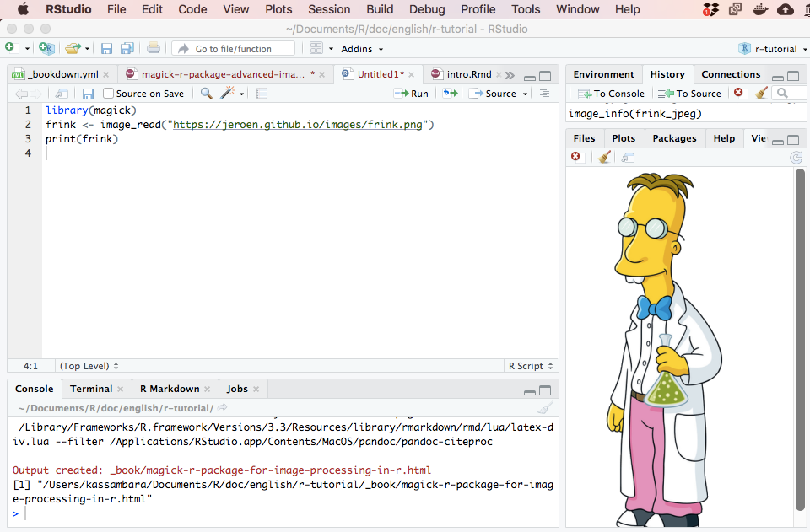
THANK YOU SOUNAK CHAKRABORTY CHAKRABORTYS@MISSOURI.EDU http://faculty.missouri.edu/chakrabortys/

